Slide 1
MGMT 658 – Mastering Agile and Scrum
Case III – Agile Transformation of Raiffeisenbank: Culture First
An article by Stanislav Shekshnia
Group 1 & 6
Yashwanth Nomula
Sumanth Bhuma
Venkata Ramya Maddineni
Ameya Desai
Priyaja Shankar Jena
Part 2

Slide 2
Part II – Question I
Describe the key results of the transformation. Was it a success?

Slide 3
Key Results of Transformation
Strategic Shift Towards Digitalization
Driving Profitability and Market Recognition
Enhanced Customer Engagement
Positioning for COVID-19 Impact: Navigating External Challenges
Notes:
These were the key results of the transformation:
Strategic Shift Towards Digitalization
Driving Profitability and Market Recognition which shows the financial strength
Enhanced Customer Engagement which shows increased digital service utilization
Resilience During External Challenges : Covid 19 Impact

Slide 4
Strategic Shift Towards Digitalization
Transitioned from Traditional to Digital
Reallocation of Resources
Emphasis on Digital Channels
Streamlining Operations
Notes:
Now Lets get into Details of each: Raiffeisenbank underwent a successful transformation, shifting its focus from traditional banking methods to a digitally-driven value network.
Reallocation of Resources: The bank strategically reallocated resources from traditional processes towards digital infrastructure and services.
Emphasis on Digital Channels: The bank prioritized digital channels, including mobile and internet banking, as primary channels for customer interactions and service delivery.
Streamlining Operations: By embracing digital channels, bank streamlined its operations, reducing reliance on physical branches and optimizing service delivery processes.

Slide 5
Financial Strength
Driving Profitability and Market Recognition
Recognition by Forbes
In 2019, Forbes recognized Raiffeisen bank as one of Russia's top three most reliable banks
Record Profit
In 2019, the bank recorded a profit of 37.6 billion rubles, showcasing robust financial performance.
Operating Cost Increase
In 2019, operating costs increased by 10.7% to reach 36.2 billion rubles compared to the previous year.
Decline in Return on Equity
2019 saw a 2.3% decrease in ROE, signaling lower profitability than the year before.
Notes:
Forbes Recognition: Raiffeisenbank got a big thumbs-up from Forbes in 2019, ranking among the top 3 most trustworthy banks in Russia. It's like getting a gold star for being reliable and solid in the banking world.
Record Profits: The bank hit the jackpot in 2019, making a whopping profit of 37.6 billion rubles. That's a lot of money and shows that the bank is doing really well financially.
Costs Went Up: But, there's a catch. The bank had to spend more money on running things in 2019. Operating costs went up by 10.7%, reaching 36.2 billion rubles. It cost more to keep the bank running smoothly.
Profit Dip: Also, the profit didn't grow as much as hoped. The return on equity, which shows how much profit a company makes compared to its shareholders' money, dropped by 2.3 percentage points in 2019. So, even though they made a lot of money, they didn't make as much compared to before.

Slide 6
Enhanced Customer Engagement
Increased Digital Service Utilization
Loan applications via Raiffeisen-Online app: 40% in 2018, 70% in 2019
Increase in online deposits and savings accounts
Private customer growth: 12% by end of 2019, reaching two million
Corporate client segments also grew by 10-15%
Ranked second in NPS by NAFI research center, after Tinkoff Bank
Notes:
Loan Apps Soared: More folks preferred their Online app for loans. From 40% in 2018, it skyrocketed to 70% by 2019.
Online Banking Surge: Not just loans, but also deposits and savings accounts spiked online. People found it easier to manage their money digitally.
Growing Family: customer base grew by 12% by 2019, hitting two million for private customers. Even their corporate clients grew by 10-15%.
Happy Customers: More customers recommended them, boosting their reputation. They ranked second in customer satisfaction, just behind Tinkoff Bank.

Slide 7
Resilience During External Challenges
Covid-19 Impact
Resilience through Agility
Proactive Digital Adaptation
Remote Operational Continuity
Enhanced Customer Satisfaction
Notes:
COVID Test: The pandemic tested the bank's strength, but the Agile transformation helped the bank sail through.
Preparedness Pays Off: The bank took proactive steps like boosting their digital setup and enabling remote work.
Serving Customers: With these measures, They could serve their customers seamlessly from afar, keeping their operations smooth.
Happy Customers: Their Agile approach not only kept them afloat but also made their customers happier during the tough times.

Slide 9
Part II – Question 2
What was the role of the CEO in the transformation?

Slide 10



CEO's Role in Raiffeisen bank's Transformation
Visionary Leader
Change Champion
Strategic Decision-Maker
Set clear vision and strategic direction for digital transformation
Advocated for the transformation across the organization
Made critical decisions about resources, strategy, and priorities
Promoting Agile practices, LeSS framework adoption
New roles - Product Owners, Tech lead, scrum master
Ownership, Collaboration and Customer-centricity
Notes:
The CEO played a critical role in steering Raiffeisenbank's digital transformation journey.
The three key aspects of the CEO's role that were instrumental in driving organization forward in this era of digital disruption
Setting the Vision and Strategic Direction:
The CEO didn't just talk about transformation, He clearly articulated a vision for the future.
This vision, unlike traditional top-down approaches, revolved around three key principles : Ownership, Collaboration and Customer-Centricity
**Ownership:** Empowering employees to take ownership of their work fosters a sense of accountability and drives better results.
* **Collaboration:** Breaking down silos and encouraging teamwork allows for the exchange of ideas and fosters innovation.
* **Customer-Centricity:** Placing the customer at the core of everything ensures the transformed bank delivers a superior customer experience.
By setting a vision centered on these principles, the CEO fostered a culture of autonomy and innovation within Raiffeisenbank
Championing Change and Inspiring Transformation:
Monin actively promoted the adoption of Agile practices and the LeSS framework, encouraging teams to collaborate and innovate.
By actively promoting these practices, the CEO not only championed change but also likely instilled a culture of continuous improvement within Raiffeisenbank, driving teams to embrace new ways of working and enhancing efficiency.
Decision-Making and Strategic Leadership:
Vision and inspiration are crucial, but successful transformation necessitates strategic decision-making
The CEO of Raiffeisenbank made critical choices to support the transformation: he implemented roles like Product Owners, Technical Leads, and Scrum Masters.
This reshaped the organizational structure, enhancing efficiency and sharpening the focus on customer needs.

Slide 11




CEO's Multifaceted Role in Transformation
Leadership and Alignment
Fostered collaboration and communication for a unified approach
Resource Mobilization
Secured financial, human, and technological resources for transformation projects
Monitoring and Evaluation
Monitored progress, evaluated results, and made adjustments as needed
Culture Shaping
Drove a cultural shift towards innovation, agility, and a customer-centric focus
Notes:
Responsibilities of CEO went beyond just setting the vision.
He acted as a unifier, fostering collaboration and communication between leadership teams, employees, and stakeholders.
This ensured everyone worked towards the same goals and understood their roles in the transformation.
He also played a crucial role in securing the necessary resources, financial, human capital, and technological advancements, to enable the successful implementation of transformation projects. He led the initiative to secure additional funding for the digital transformation projects
Furthermore, he closely monitored progress, and implemented a system to track key performance indicators (KPIs) related to the transformation process., also evaluated the impact of the changes on the organization
Finally, the CEO played a vital role in shaping the organizational culture. By embodying the values of innovation, agility, and a customer-centric approach, he influenced a cultural shift that supported the digital transformation journey.

Slide 12


CEO's Dual Role
Visionary Focus: Advocated for and drove transformation initiatives
Rallying Cry: Communicated need for change and inspired employees
Goal Setting: Set vision and clear objectives
Unwavering Commitment: Demonstrated commitment to the change
Structure & Accountability: Established accountability framework
Clear Expectations: Set clear expectations & KPIs
Enforced new processes & procedures
Structured Change: Create structured environment for change by setting expectations.
Progress Monitoring: Hold teams accountable, monitor progress, and make data-driven decisions
Inspiring Leader
Enforcer
Notes:
The CEO at Raiffeisenbank wasn't just one thing; he wore two hats. On one hand, he was the inspiring leader, the champion for change while he also played the role of the enforcer, the forcing function for the rules.
As a Champion of Change,
The CEO played a crucial part in setting the direction for Raiffeisenbank's digital future.
He established a compelling vision, outlining the need for change and the exciting opportunities it presented.
This vision likely addressed the challenges of the digital age, the evolving customer landscape, and the need for innovation.
By effectively communicating this vision, setting clear objectives, and demonstrating commitment to the transformation, the CEO motivated employees to align with the organizational changes.
A compelling vision is just one piece of the puzzle.
The CEO also acted as an enforcer, creating a structured environment to turn that vision into reality
He established a framework of accountability, governance, and performance management to ensure the successful implementation of the transformation.
Through setting expectations, defining KPIs, and enforcing compliance with new processes and procedures, the CEO created a structured environment for change.
By holding teams accountable, monitoring progress, and making data-driven decisions, the CEO ensured that the transformation initiatives were executed effectively and aligned with the strategic objectives of the organization.
By leading with both vision and structure, the CEO's dual role guided Raiffeisenbank through a successful transformation.

Slide 14
Part II – Question 3
What challenges might the leadership team face in the near future?

Slide 15
Challenges
Security and Compliance
Balancing Autonomy and Control
Maintaining Employee Engagement
Talent Management
Evolving Technology
Notes:
Balancing Autonomy and Control:
Security and Compliance: Balancing the agility of the Agile approach with robust security measures and compliance with financial regulations is an ongoing challenge for banks.
By proactively addressing these potential challenges, the leadership team can ensure the long-term success of Raiffeisenbank's Agile transformation journey.
Empowered Teams vs. Overall Strategy: The case study emphasizes decentralized decision-making with autonomous product teams. However, the leadership team might need to find ways to ensure these teams remain aligned with the bank's overall strategic objectives.
Standardization and Consistency: With multiple teams working independently, maintaining consistency in user experience, product quality, and technical standards across the bank's digital offerings could be a challenge.
Long-Term Sustainability:
Maintaining Employee Engagement: The initial excitement of a new way of working can fade over time. The leadership team will need to find ways to keep employees motivated, engaged, and continuously learning in the Agile environment.
Scaling Agile: The success of the initial transformation might lead to further scaling the Agile approach across the entire organization. This could introduce new complexities in managing a large number of autonomous teams.
Integration with Parent Company: Raiffeisenbank is a subsidiary of a larger Austrian parent company. Balancing the bank's Agile approach with the parent company's potentially more centralized structure could be a challenge.
Additional Challenges:
Talent Management: Finding and retaining employees with the right skillsets for Agile development and digital banking remains crucial. The leadership team will need to address potential skill gaps and ensure a competitive talent pipeline.
Evolving Technology: The technological landscape is constantly changing. The leadership team will need to stay updated on emerging technologies and ensure the bank's Agile practices can adapt and integrate new tools effectively.

Slide 16
Challenges (Cont.)
Economic Uncertainty
Changing Customer Expectations
Demographic Shifts
Changing Payment Landscape
Data Privacy

Slide 18
Part II – Question 4
Think about the selection of LeSS as a framework for scaling agile. From your perspective, was this the best choice (if so, why?) or should another option receive consideration (and why)?

Slide 19
Why LeSS was the Best Choice for Raiffeisenbank?
Alignment with Organizational Culture
LeSS emphasis on minimal hierarchy and promoting team autonomy aligns cultural shift towards "comfortable entrepreneurship” and decentralized decision-making
Simplicity and Scalability
LeSS provides a straightforward framework that extends Scrum practices to multiple teams without adding excessive complexity
Proven Effectiveness in Large Settings
LeSS has been effectively applied in various large-scale organizations, offering a clear framework with flexibility to adapt to specific organizational needs
Notes:
Alignment with Organizational Culture: LeSS emphasis on minimal hierarchy and promoting team autonomy aligns with Raiffeisenbank's cultural shift towards "comfortable entrepreneurship" and decentralized decision-making.
Simplicity and Scalability: LeSS provides a straightforward framework that extends Scrum practices to multiple cross-functional team without adding excessive complexity, LeSS allowed for scaling agile practices across multiple teams working on large products simultaneously, which was a requirement for Raiffeisenbank's transformation.
Proven Effectiveness in Large Settings: LeSS has been effectively applied in various large-scale organizations, offering a clear framework with enough flexibility to adapt to specific organizational needs, making it suitable for Raiffeisenbank's size (over 8,000 employees) and scope of digital transformation.

Slide 20
Comparison with Other Frameworks
Scaled Agile (SAFe): Often considered more prescriptive and complex, potentially offering less flexibility compared to LeSS. SAFe involves multiple layers of governance and roles that might not align with the lean and autonomous structure desired by Raiffeisenbank
Disciplined Agile (DA): Provides a toolkit approach allowing for more customization but requires a deeper understanding and more extensive change management to implement effectively, which could slow down the transformation process
Scrum of Scrums: Suitable for smaller scales than Raiffeisenbank's needs. It focuses mainly on coordination between teams rather than a comprehensive scaling of agile practices across large enterprises
Spotify Model: Highly autonomous and less structured, which could risk diluting strategic alignment across the bank's large-scale operations. It also lacks the formalized scaling mechanism that LeSS offers, which is crucial for maintaining coherence in large product developments
Notes:
Scaled Agile (SAFe): Often considered more prescriptive and complex, potentially offering less flexibility compared to LeSS. SAFe involves multiple layers of governance and roles that might not align with the lean and autonomous structure desired by Raiffeisenbank.
Disciplined Agile (DA): Provides a toolkit approach allowing for more customization but requires a deeper understanding and more extensive change management to implement effectively, which could slow down the transformation process.
Scrum of Scrums: Suitable for smaller scales than Raiffeisenbank's needs. It focuses mainly on coordination between teams rather than a comprehensive scaling of agile practices across large enterprises.
Spotify Model: Highly autonomous and less structured, which could risk diluting strategic alignment across the bank's large-scale operations. It also lacks the formalized scaling mechanism that LeSS offers, which is crucial for maintaining coherence in large product developments.

Slide 21
Strategic Benefits of Implementing LeSS at Raiffeisenbank
Enhanced Collaboration and Integration:
LeSS breaks down silos and fosters collaboration and innovation by encouraging cross-functional teamwork
Focus on Customer-Centric Products:
LeSS framework ensures that teams are aligned towards delivering customer value, critical goal of enhancing digital customer experiences
Adaptability:
LeSS allowed bank to adapt processes quickly and incorporate feedback effectively, essential for fast-paced financial services sector
Cost-Effectiveness:
By minimizing additional roles and artifacts, LeSS helps keep the transformation lean and cost-effective
Notes:
Enhanced Collaboration and Integration: By encouraging cross-functional teams to work together towards a common goal, LeSS helps break down silos, fostering better collaboration and innovation across the bank
Focus on Customer-Centric Products: LeSS's framework ensures that all teams are aligned towards delivering customer value, which is critical for Raiffeisenbank's goal of enhancing digital customer experiences
Adaptability and Continuous Improvement: LeSS allows Raiffeisenbank to adapt processes quickly and incorporate feedback effectively, essential for the fast-paced financial services sector
Cost-Effectiveness: By minimizing additional roles and artifacts, LeSS helps keep the transformation lean and cost-effective, aligning with the bank's efficiency goals

Slide 23
Part II – Question Five
Today, Raiffeisen Bank International expects to be told by European regulators to slash lending and payments involving Russia.
According to the latest draft of proposals from the European Central Bank (ECB), RBI will need to cut loans to customers in Russia and international payments from Russia by 65% before 2026.
RBI has repeatedly committed to spinning off its Russian division over the course of the past two years since the invasion but has failed to do so.
How could the decision to adopt agile thinking and the LeSS framework potentially help RBI in making this massive adjustment to its business model in the near future?

Slide 24

Importance of Cultural Change
Notes:
Why does three need to be a change in culture for RBI’s ventures to succeed?
Agile methodologies focus on a cultural shift towards embracing change, flexibility, and continuous improvement.
For our organization, this cultural adaptability can help in rapidly adjusting to the new regulatory environments and operational constraints.
The shift to a culture that values agility over rigid planning allows the bank to respond swiftly to external changes such as regulatory demands.

Slide 25

The call for Servant Leadership
Notes:
Agile frameworks often emphasize servant leadership, where leaders prioritize support for their teams over command-control tactics.
This can enhance RBI's ability to make the significant adjustments required by the regulators by empowering employees to take initiative and make decisions that align with the strategic shift without waiting for top-down directives.
Building a supportive environment that enhances employee engagement and accountability.

Slide 26



The Agile Way
Individuals and Interactions over processes and tools
Customer collaboration over contract negotiation
Responding to change over following a plan
Notes:
Implementing agile principles such as prioritizing individuals and interactions, customer collaboration, and responding to change can guide RBI during this transition.
By focusing on these agile values, RBI can maintain operational effectiveness and customer service quality even as it scales down certain aspects of its operations.

Slide 27
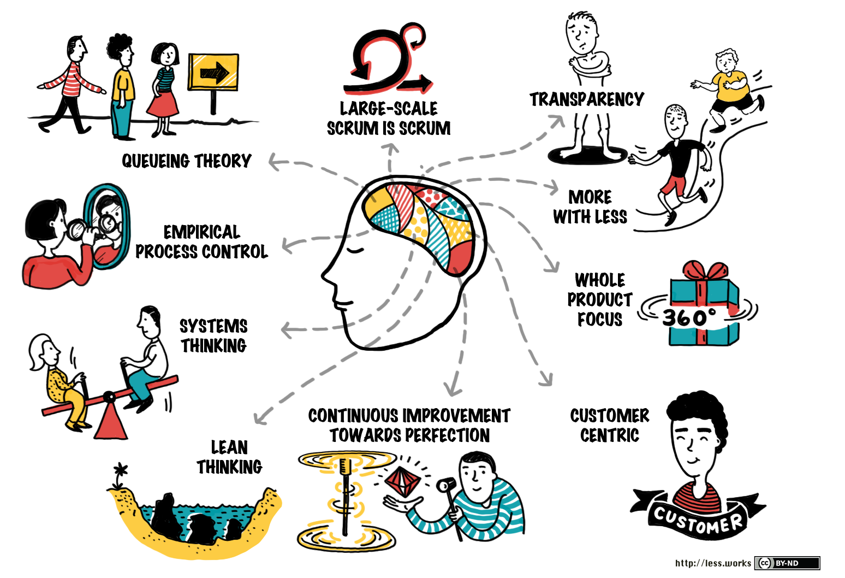
What is LeSS?
Notes:
LeSS provides a structured approach to scaling agile practices in large organizations like RBI.
It helps integrate various departments and teams to work cohesively on large-scale projects.
Adopting LeSS could enable RBI to streamline the processes involved in reducing its exposure to the Russian market by enhancing collaboration across multiple teams, thus ensuring that changes are implemented effectively and uniformly.

Slide 28
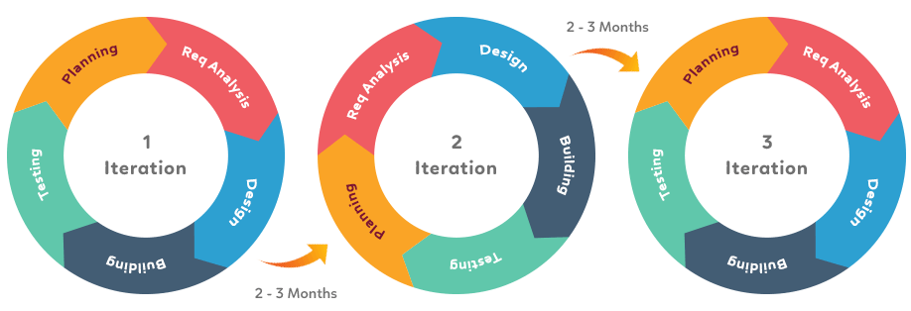
Iterative and Incremental
Notes:
The agile approach of developing through small, manageable increments and frequent iterations allows RBI to make gradual adjustments in its operations.
This method not only mitigates risks by allowing for adjustments based on real-time feedback but also ensures that the bank can meet the regulatory requirements progressively, without disrupting ongoing operations.

Slide 29

Communication and Collaboration
Notes:
Agile frameworks enhance transparency and communication within teams, which is crucial when dealing with complex regulatory changes.
Regular meetings and updates, as prescribed by agile methodologies, would ensure that all team members are aligned with the new objectives and compliance requirements.

